Slide 1
Fii explain why adjusting Harvatek LED brightness is not recommended
Cooper Kung
2023/11/28

Slide 2
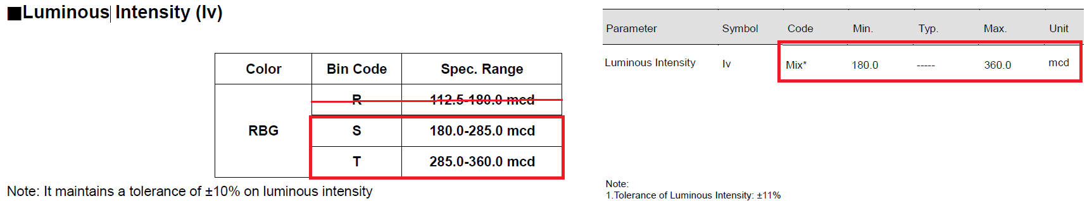
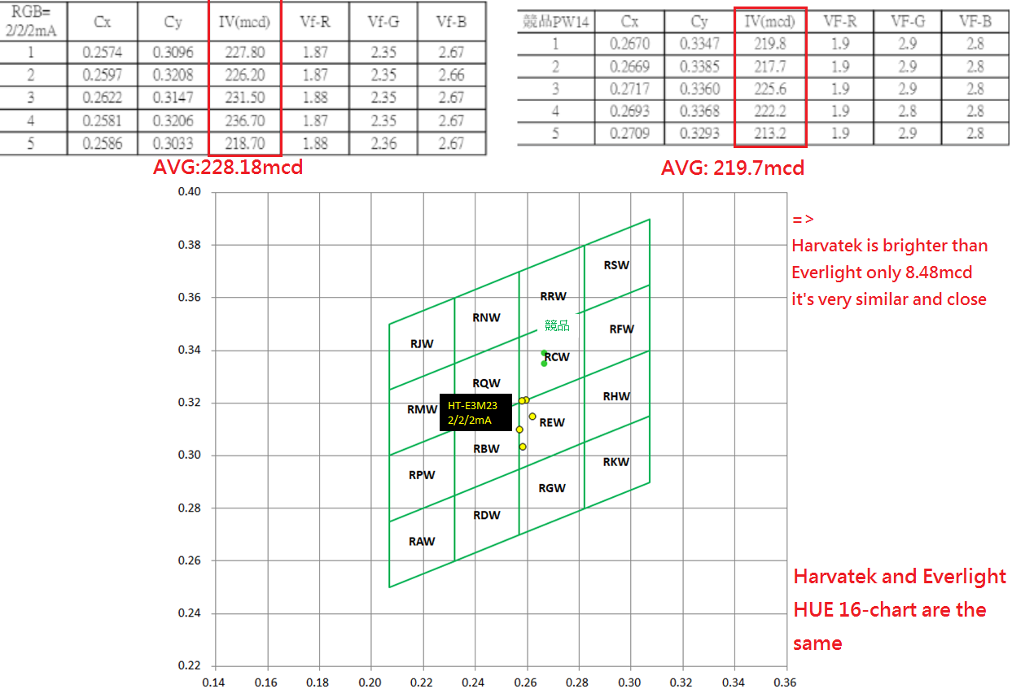
2a:
Harvatek brightness range: Everlight brightness range:
Color: ALT has agreed to the 2/2/2mA color
Brightness: ALT require Harvatek brightness to be tuned down
a. So far, Fii use Harvatek bin code S, T on mass production, it’s
same as Everlight
b. Actual test between Harvatek and Everlight are similar, also locate
on Everlight spec.
c. Risk: if adjust brightness, the color will shift and there is no other
way except replacing the LED IC
d. Fii doesn’t recommend adjusting the brightness:
i: Schedule.
ii: Harvatek bin code S,T range will revise down, it will be not
the same as Everlight.
iii: Risk of adjusting brightness.
Summary: Harvatek(Bin Code: S, T) and Everlight brightness are the same
2b:
Harvatek actual test brightness: Everlight actual test brightness:
Summary: Harvatek and Everlight actual test result are similar, also locate on Everlight 16-chart Spec.

Slide 3
Thank you

